Slide 1
Smart Notes
-Developed by
Anurag pateriya (2019201057) Vaibhav mandir(2019201060)
Vishal Malhotra(2019201018) Manish Chetwani(2019201036)
Jatin Khachane(2019201043) Ayush Agrawal(20161195)

Slide 2
Problem Description
One of the problems with the conventional way of writing class notes on a notebook is that they are not portable.It is not possible to have them with you at all times and they occupy a lot of space.
However we can deal with this by capturing images of the notes and storing them on the phone.
But it often happens that they are either a little blurred or require zooming to clearly identify the text.
Images also occupy a lot of storage space on your device.

Slide 3
Key issues we are targeting
We face following problems with handwritten notes :-
Unclean
Readability
Editability
Reliability
Shareability
Portability
Fragility
Storage Space consumption

Slide 4
Scope of Our Project
This product will be used by all individuals who need to convert their notes to text document
We wish to develop this as an online tool which takes input an image /number of images and converts them into text pages and return pdf back to the user.
At this stage, we have developed a command line tool which takes input single image and saves the output into output.txt.

Slide 5
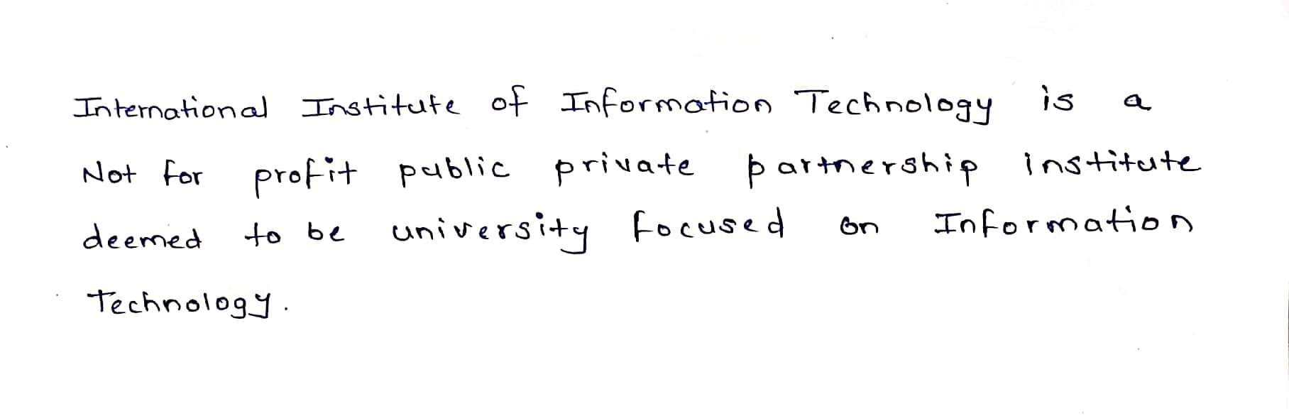
Preprocessing
Image Preprocessing : Image Preprocessing Initially resizing image, smoothing, binarization is done in this step
Line Segmentation : In this step the entire image is segmented into line such that one image corresponds to one line
Word Segmentation : In this one by one each line is segmented into words such that one image corresponds to one word.

Slide 6
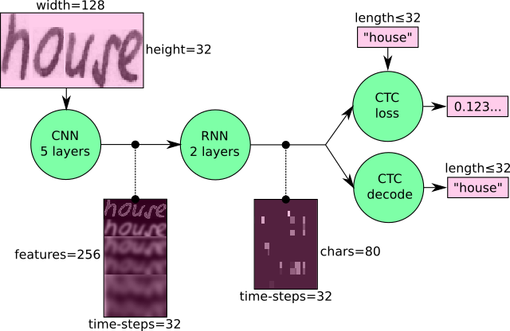
Model Configuration
It consists of 5 CNN layers, 2 RNN (LSTM) layers and the CTC loss and decoding layer. The illustration below gives an overview of the NN (green: operations, pink: data flowing through NN).
The input image is a gray-value image and has a size of 128x32 5 CNN layers map the input image to a feature sequence of size 32x256 2 LSTM layers with 256 units propagate information through the sequence and map the sequence to a matrix of size 32x80.

Slide 7
Coding principles used
Self-explainable code
Modular
KISS - we divided the code into simpler components as much they were possible
Every class we divided holds a single responsibility
We tried to remove non-repeatable code.
We followed Open/Closed principle.
Code is necessarily commented for better understanding of code complexity

Slide 8
Management due to remote teams
This project was divided into 2 independent components:
Preprocessing and Segmentation : This component is responsible for preprocessing of image to use on our model and Segmentation to extract words from the image.
Model Training : This component is responsible for loading training data and training the model.
Each of these components were handled by a team of 3 people each.
Preprocessing and Segmentation was handled by Jatin, Manish and Vaibhav whereas Model Training was implemented by Ayush, Anurag and Vishal.

Slide 9
Future Scope
In the later versions of our software, we will be able to handle :
Diagrams and their labels
Distinguish underlined text and highlight it.
Distinguish headings and subheadings and show the hierarchy in the document .
We intend to port our application to android and ios.

